Slide 1

High Impact Skills Development Program
in Artificial Intelligence, Data Science, and Blockchain
Module 8: Object Detection & Recognition Using CNN
Lecture 4: Object Detection Architectures: YOLO
Instructor: Ahsan Jalal

Slide 2
Previously
Aspect | R-CNN | Fast R-CNN | Faster R-CNN
Publication Year | 2014 | 2015 | 2015
Region Proposal Method | Selective Search (External Algorithm) | Selective Search (External Algorithm) | Region Proposal Network (RPN) (Integrated)
Feature Extraction | CNN on each region proposal | Single CNN on the entire image | Single CNN on the entire image
Classification | SVM classifier on extracted features | Softmax layer in CNN | Softmax layer in CNN
Bounding Box Regression | Separate linear regressor | Integrated in the network | Integrated in the network
Speed | Slow (takes around 47s per image) | Faster than R-CNN (2s per image) | Much faster (0.2s per image)
Pros | Pioneering approach using deep learning | Improved speed and simpler training | Integrated proposal generation, much faster
Cons | Slow, multi-stage, requires lots of storage | Still relies on slow Selective Search | Complex RPN but highly efficient
R-CNN
Fast R-CNN
Faster R-CNN
SSD
Mask R-CNN
Pros Vs. Cons

Slide 3
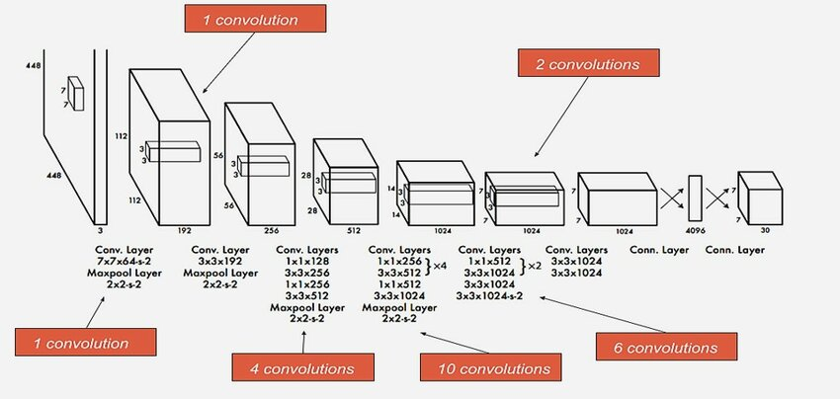
Introduction to YOLO
YOLO (You Only Look Once) is a fast and real-time object detection model.
Introduced by Joseph Redmon et al. in 2016.
It frames object detection as a single regression problem, predicting bounding boxes and class probabilities directly from full images in one pass.

Slide 4
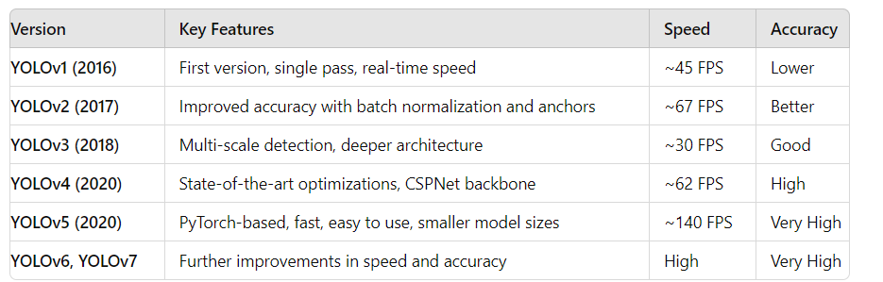
Key Features of YOLO
Single Forward Pass: YOLO performs detection in a single pass through the network.
Real-Time Speed: It can process up to 45 frames per second (FPS) with YOLOv1 and up to 155 FPS with YOLOv4-tiny.
Global Context: YOLO looks at the entire image, not just regions of interest, resulting in fewer false positives on background objects.

Slide 5
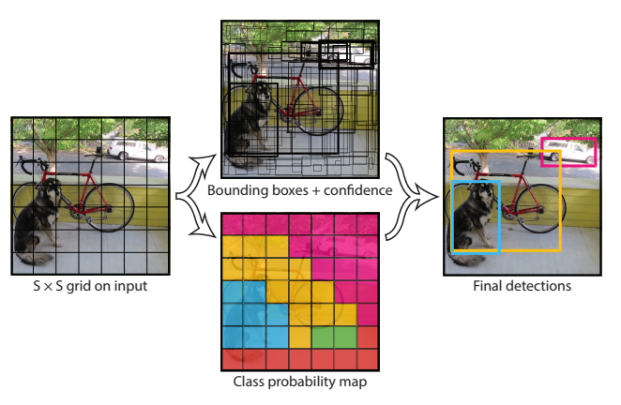
Architecture of YOLO
YOLO uses a single neural network to predict bounding boxes and class probabilities from a given image.
The image is divided into an S x S grid, and each grid cell predicts a set of bounding boxes and their corresponding confidence scores.
Each grid cell predicts B bounding boxes.
Each box includes: x, y (center of the box), w, h (width and height), and a confidence score.

Slide 6
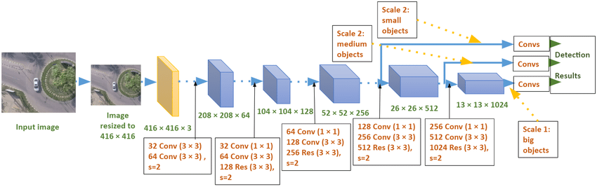
YOLOv3
YOLOv3 (You Only Look Once, Version 3) is a real-time object detection model.
Introduced by Joseph Redmon and Ali Farhadi in 2018.
Builds upon the ideas of YOLOv1 and YOLOv2 with significant improvements in accuracy and multi-scale object detection.
Combines the speed of YOLOv1 and YOLOv2 with higher accuracy.
Detects objects at different sizes by using multiple feature maps.
Uses sigmoid activation for class prediction, which avoids vanishing gradients as caused by Softmax function.
YOLOv3 uses Darknet-53 as its backbone, which is a deep convolutional neural network with 53 layers.
Residual blocks are included, inspired by ResNet, for improved gradient flow.
Uses 3 x 3 and 1 x 1 filters to extract features at different scales.

Slide 7
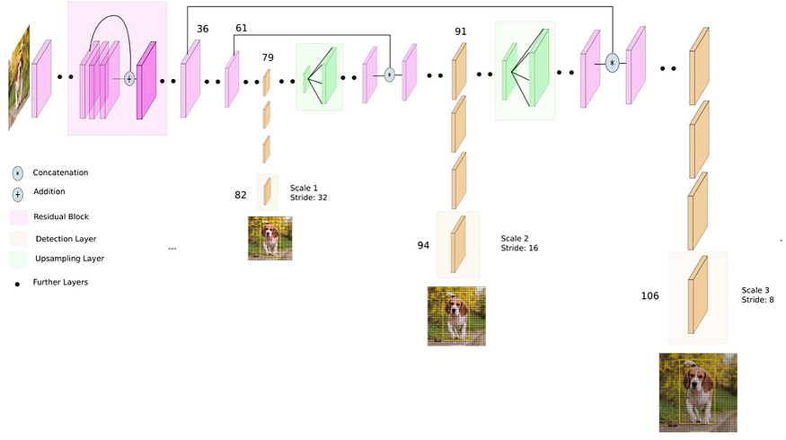
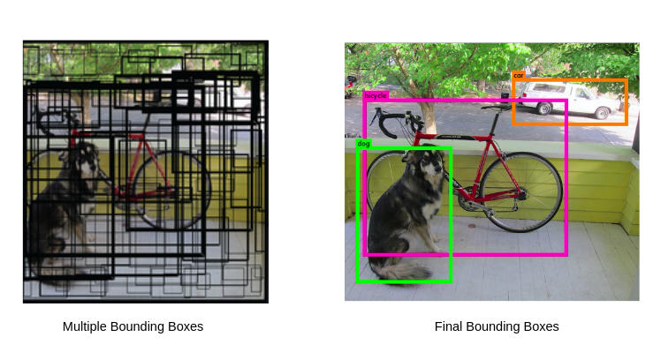
YOLOv3
YOLOv3 predicts objects at three different scales using three different feature maps: 13x13, 26x26, and 52x52.
These feature maps detect large, medium, and small objects respectively.
YOLOv3 uses 9 anchor boxes ( 3 per scale)
This allows YOLOv3 to detect objects of various sizes more effectively than previous versions.
Non-Maximum Suppression (NMS) is used to remove redundant detections.

Slide 8
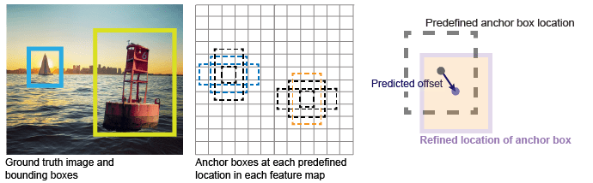
Bounding Box Prediction
YOLOv3 uses anchor boxes to predict bounding boxes by predicting these three attributes per anchor box:
Intersection over union (IoU) — Predicts the objectness score of each anchor box.
Anchor box offsets — Refine the anchor box position
Class probability — Predicts the class label assigned to each anchor box.
Predicts 4 coordinates (x, y, width, height) using logistic regression.
YOLOv3 predicts bounding boxes for each cell in the grid and each anchor box for all three scales.

Slide 9
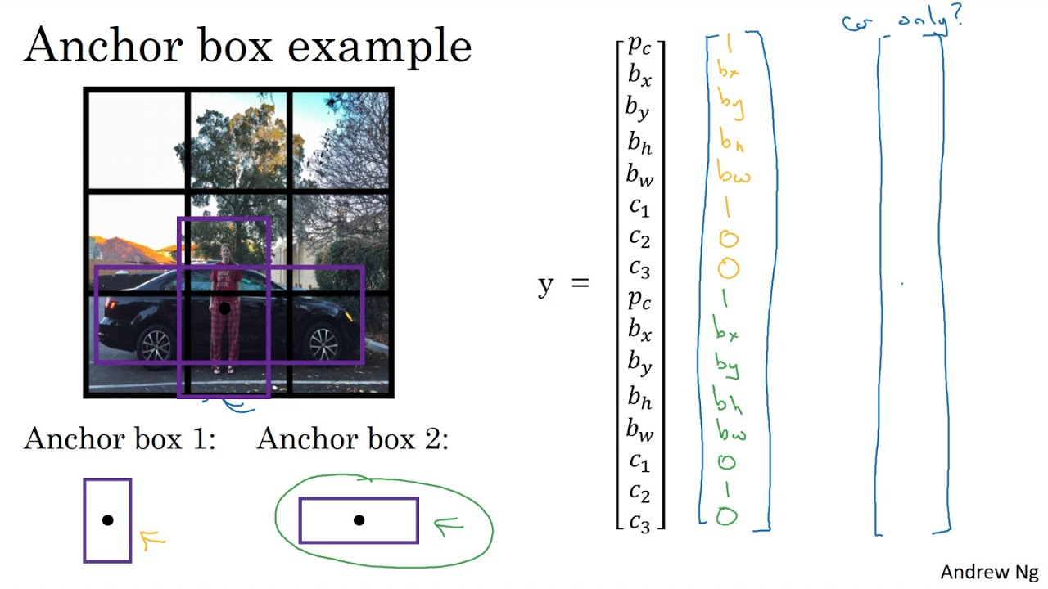
Anchor Boxes
Anchor boxes are predefined bounding box shapes based on the dataset (e.g., COCO).
YOLOv3 uses 9 anchor boxes divided across the three scales.
Anchor boxes improve accuracy by handling objects of various shapes and sizes.

Slide 10
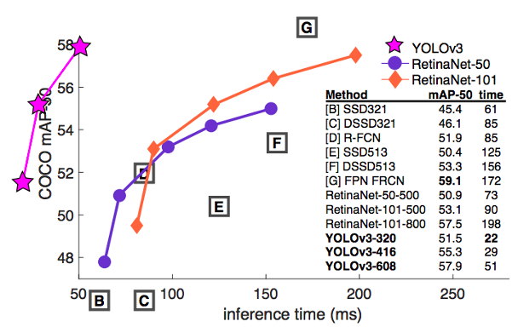
Class Prediction in YOLOv3
YOLOv3 uses independent logistic classifiers for class prediction instead of softmax assuming classes are mutually exclusive.
This allows for multi-label classification, meaning an object can belong to multiple classes (e.g., an object being both a "cat" and "animal").
Class predictions are made for each detected object, and probabilities are assigned for each class using a threshold.
An element belonging to a certain class will not be influenced by the decision of that element belonging to another class (binary cross-entropy loss).

Slide 11
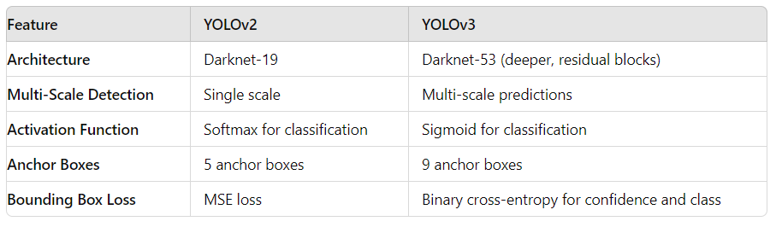
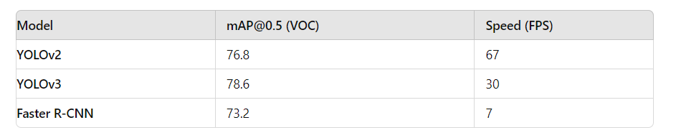
YOLOv3 Performance
Introduced in Darknet-53, YOLOv3 incorporates residual connections similar to ResNet.
With 53 convolutional layers, Darknet-53 is significantly deeper than YOLOv2’s Darknet-19.
YOLOv3 balances speed and accuracy.
For most real-time applications, it is preferred over slower but more accurate models.

Slide 12
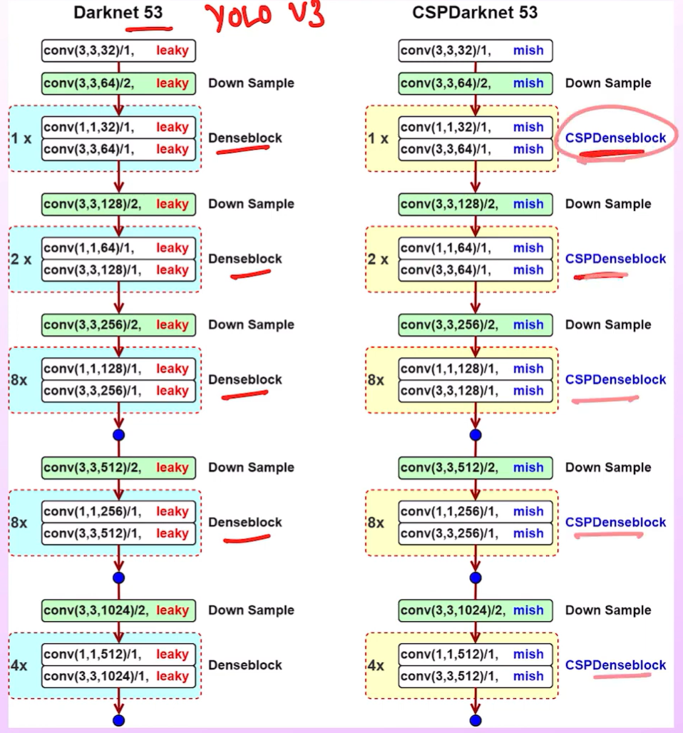
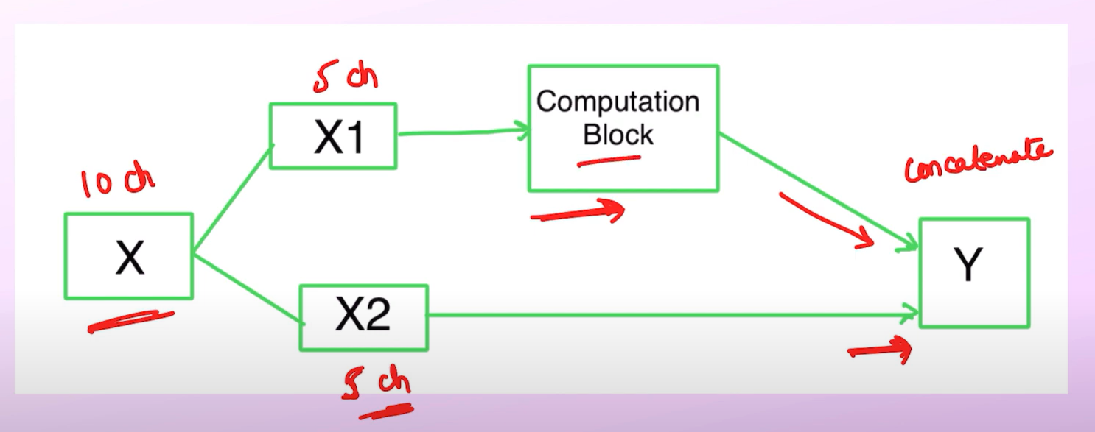
YOLOv4
Released in 2020 by Alexey Bochkovskiy and the YOLO development team.
Backbone: CSPDarknet53 (CSPNet integration to reduce computation).
CSPNet Cross Stage Partial Network involves splitting the feature maps into two parts, processing each part separately, and then concatenating the results.

Slide 13
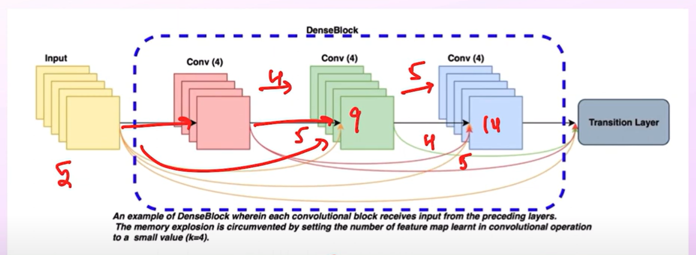
Dense Block
DenseBlock have residual connections which corresponds to too many connections.
During backpropagation too many duplicate gradients.

Slide 14
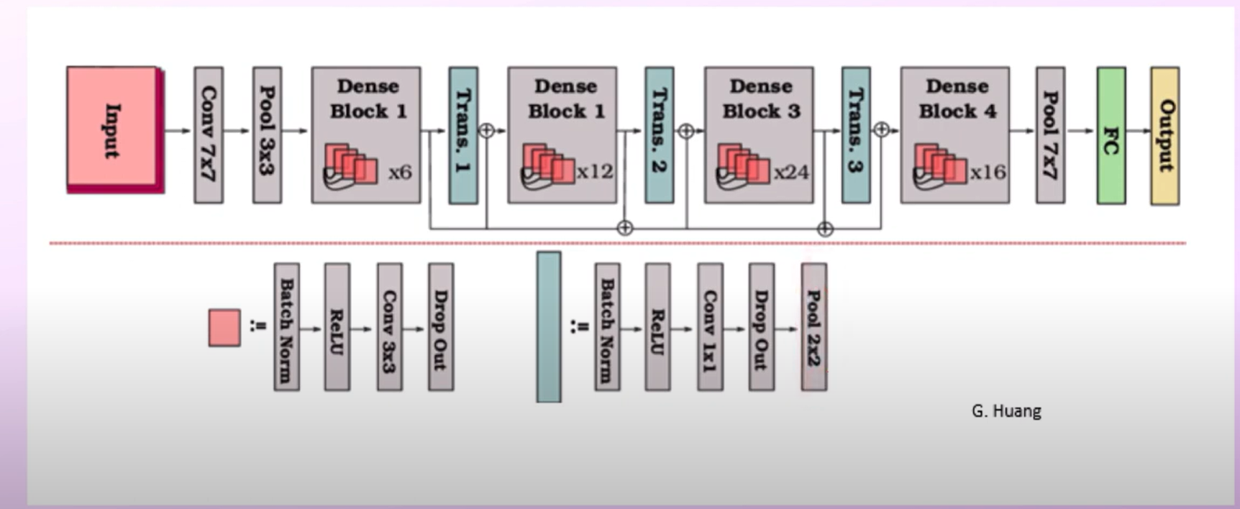
DenseNet
DenseBlock have residual connections which corresponds to too many connections.
During backpropagation too many duplicate gradients.
Transition layer is used to match the dimension for the next block.

Slide 15
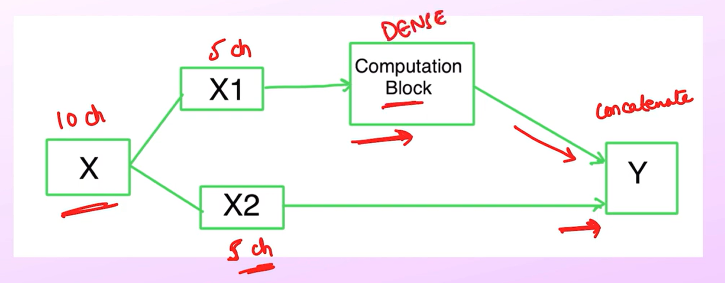
CSPNet
We pass half feature maps to the Dense block and half are concatenated directly to reduce computations.

Slide 16
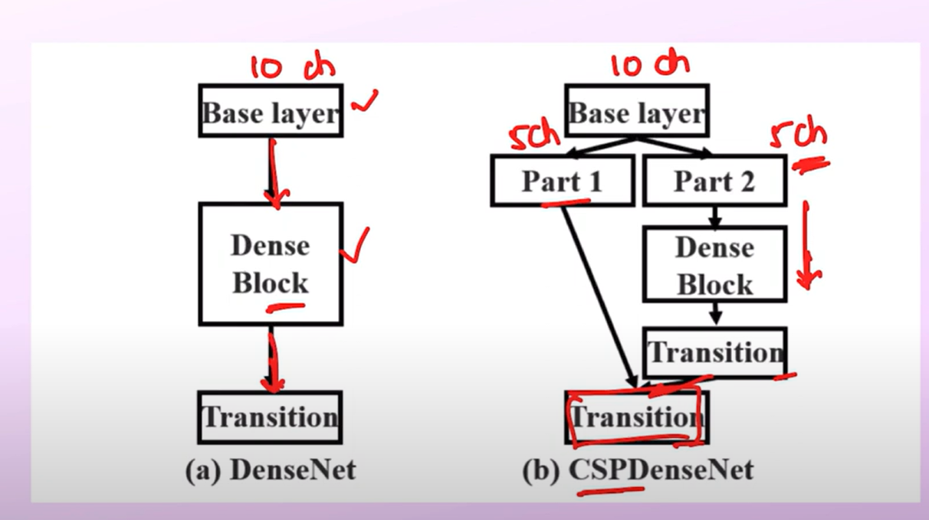
CSPNet
We pass half feature maps to the Dense block and half are concatenated directly to reduce computations.

Slide 17
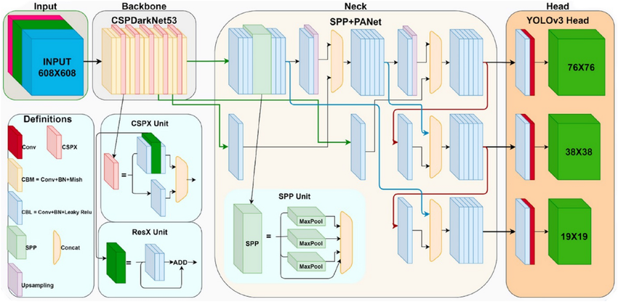
YOLOv4 Architecture

Slide 18
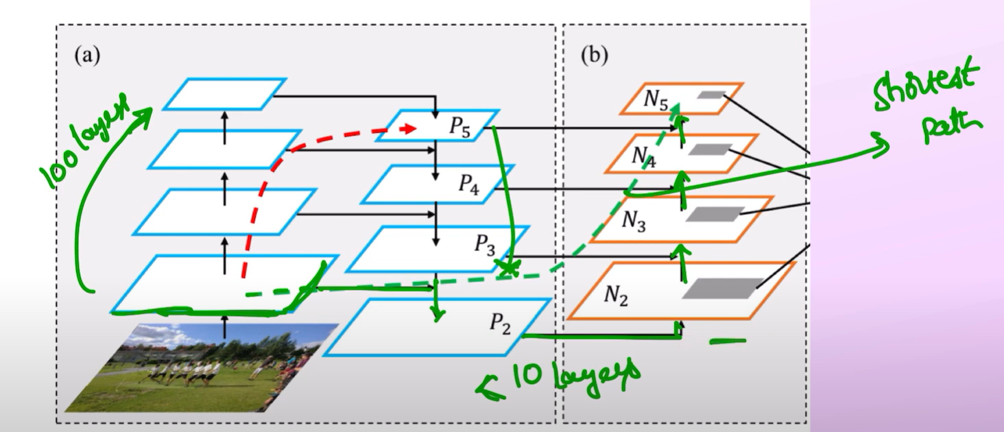
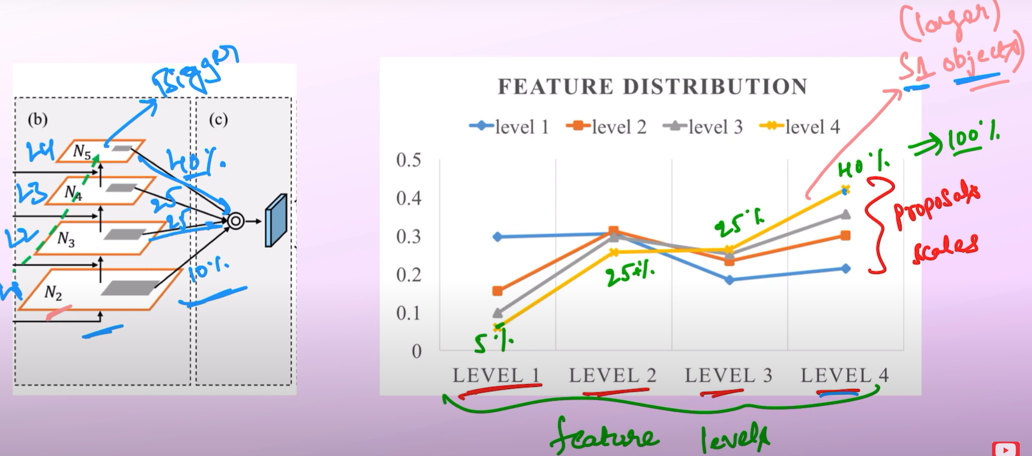
YOLOv4: Feature Extraction
Backbone: Extracts features from the input data.
Neck: PAN (Path Aggregation Network) to gather feature maps at different levels for improved object detection as well as SPP (Spatial Pyramid Pooling).
Explanation of YOLOv4 components: https://youtu.be/wMQEfzsARrw

Slide 19
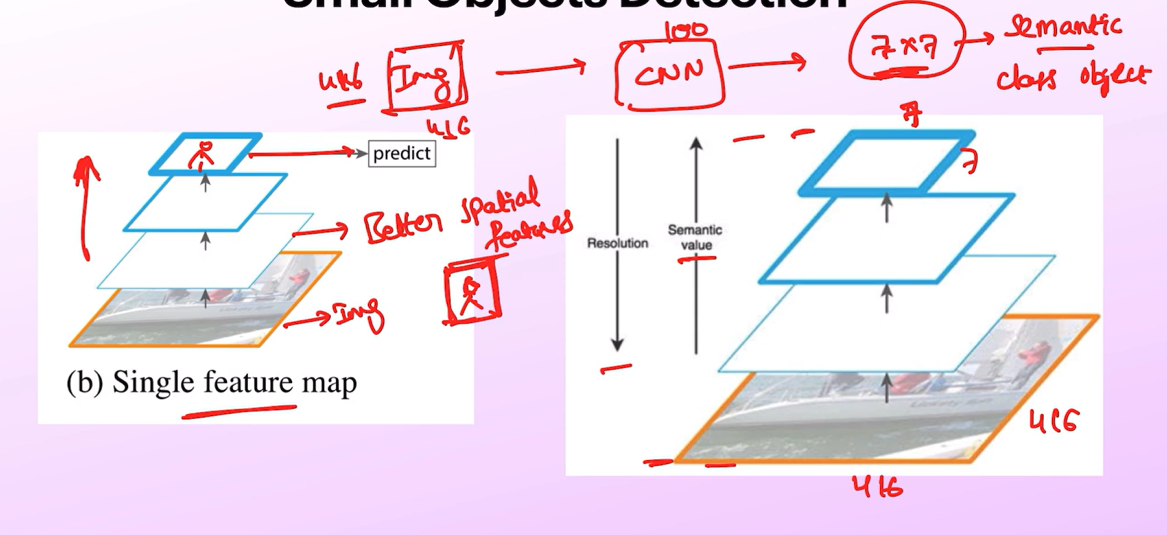
Small Object Detection
High level features have semantic information (classification).
Low level features (high resolution ) have spatial information (good for object localization).
We require semantic and spatial information for better object detection

Slide 20
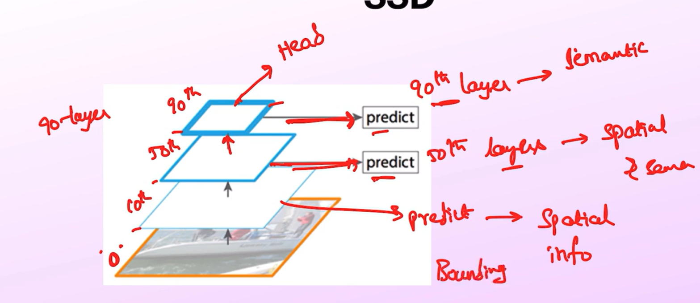
Recall from SSD
In SSD, we take feature maps at different resolutions and do object detections.
What is the issue?
Predictions at each level predictions are independent to each other.
Predictions done at high level-features have less spatial information and vice versa for low-level features.

Slide 21
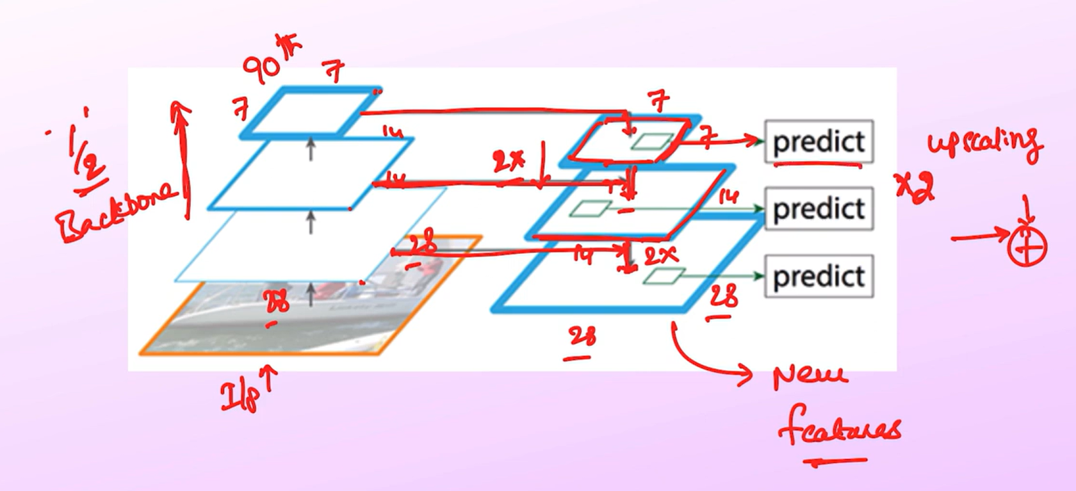
Feature Pyramid Network (FPN)
FPN solved the issue by creating new set of features by upscaling the high-level features to match the last prediction layer size.
Lateral connections are made and features are added in the the upscaled version to generate new features.
Since these features contain information from high and low level features so the features contain spatial and semantic information.

Slide 22
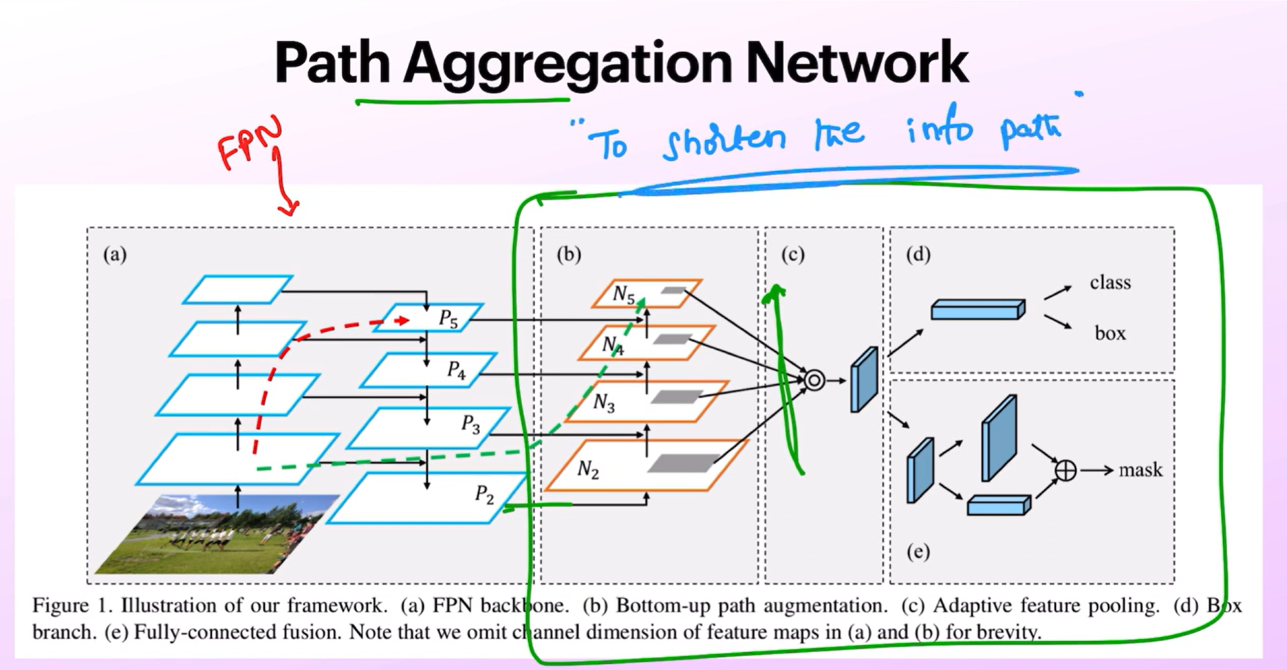
Path Aggregation Network (PAN)
FPN is not used in YOLOv4 rather PAN is used.
PAN is an extension of FPN model.
The main idea is to shorten the information path.

Slide 23
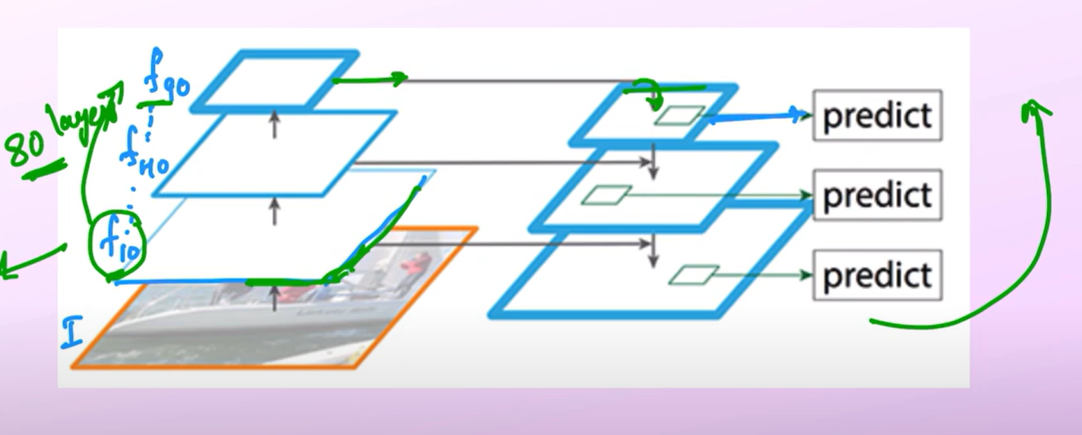
Path Aggregation Network (PAN)
We want low-level features to be accessible at high-level features for better object detection.
For that we need to apply large number of convolution layers on 10th layer to get the 90th layer but the information has been changed during the process.
Merging features in top-down path will have an information loss because we are partially getting low-level information from lateral connections.

Slide 24
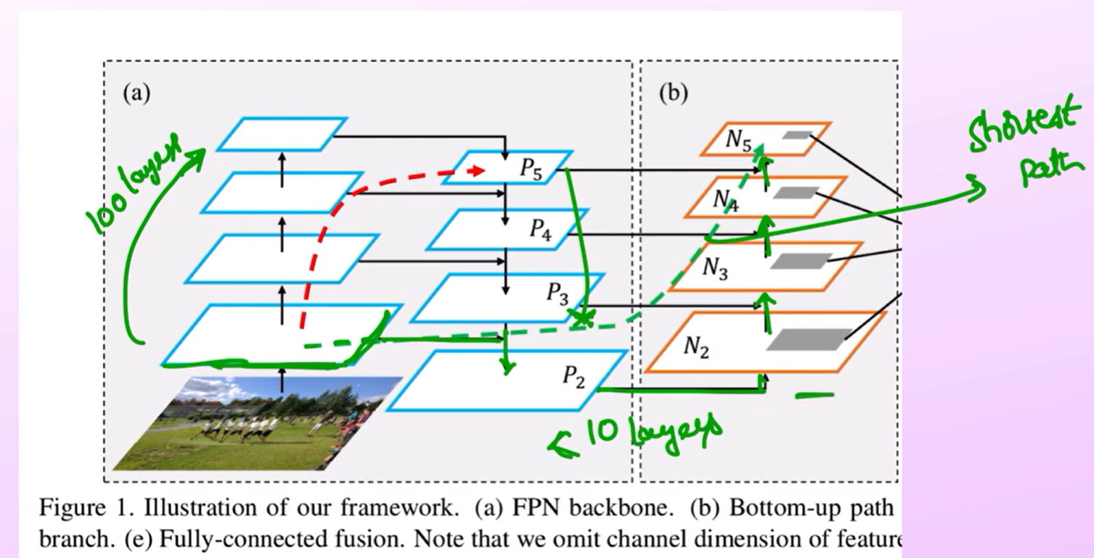
Path Aggregation Network (PAN)
Now it takes less steps to reach from low-level features to high-level features in the additional bottom-up path.
Spatial information is preserved better compared to backbone model bottom-up path.
Also it provides the shortest path for forward as well as backward pass.

Slide 25
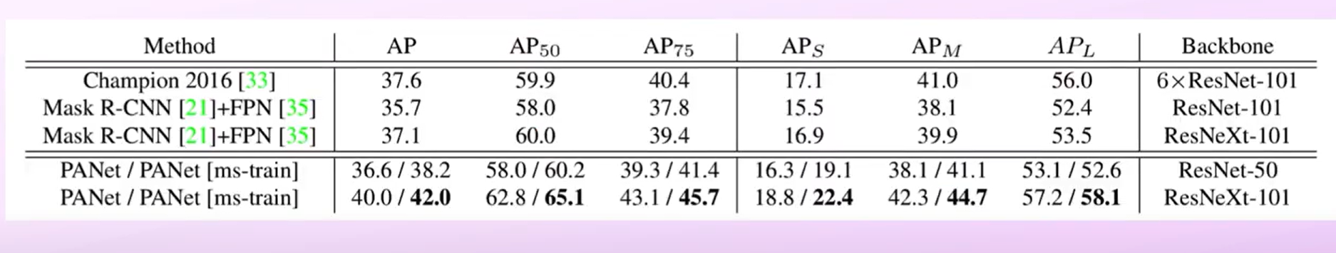
Path Aggregation Network (PAN)
Compare ResNeXt-101 backbone results for FPN and PANet
Accuracy is improved using PANet.

Slide 26
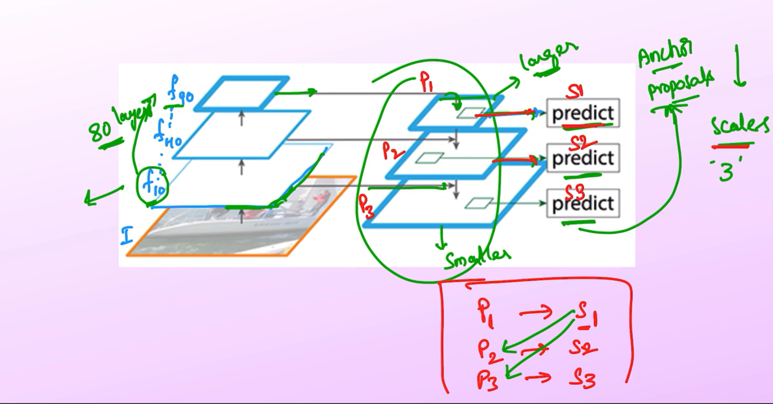
FPN issue
For different feature maps (P1,P2,P3) , we use anchor boxes of different scales (S1,S2,S3) to do predictions.
S1 can have useful information in P2,P3 as well , which is not used in FPN.
Here S1 uses P1, S2 uses P2 features only.
One of the reason for its lower accuracy compared to PAN.

Slide 27
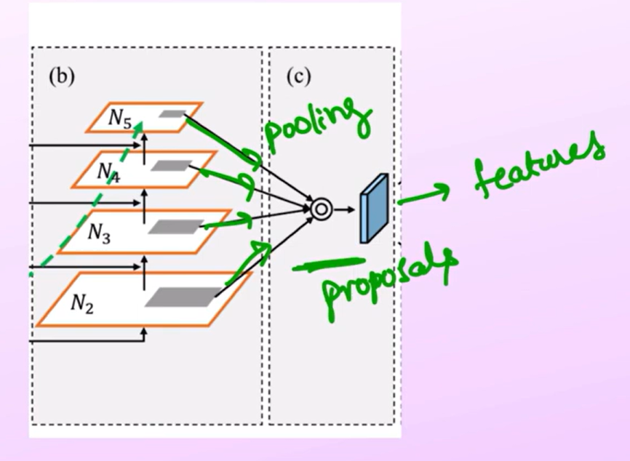
Adative Feature Pooling
The 3rd stage of PAN is adaptive feature pooling.
To choose the best features for predicting the bounding box.
Feature pooling gives the best features for predicting the particular bounding box.

Slide 28
Adative Feature Pooling
For Scale S1 (which is looking for larger objects), it is taking 55% featrure information from P2,P3 & P4 (low-level features) and 45% feature from P1.
Without Adaptive feature pooling , it was taking 100% features from P1.

Slide 29
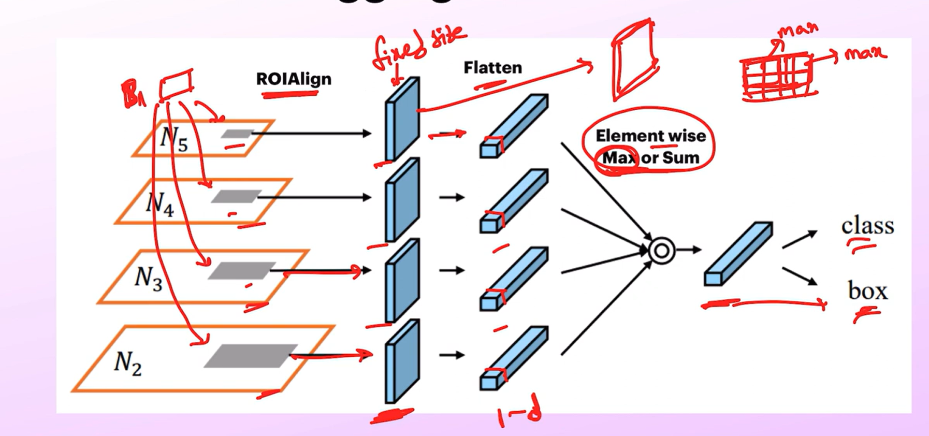
Adative Feature Pooling
In order to get features from different levels to predict a particular bounding box, features are extracted which have different shapes due to the resolution of the feature map.
ROI Align is used to get fixed-size feature maps.
Features are flatten and added together and class prediction and bounding box regression is applied.

Slide 30
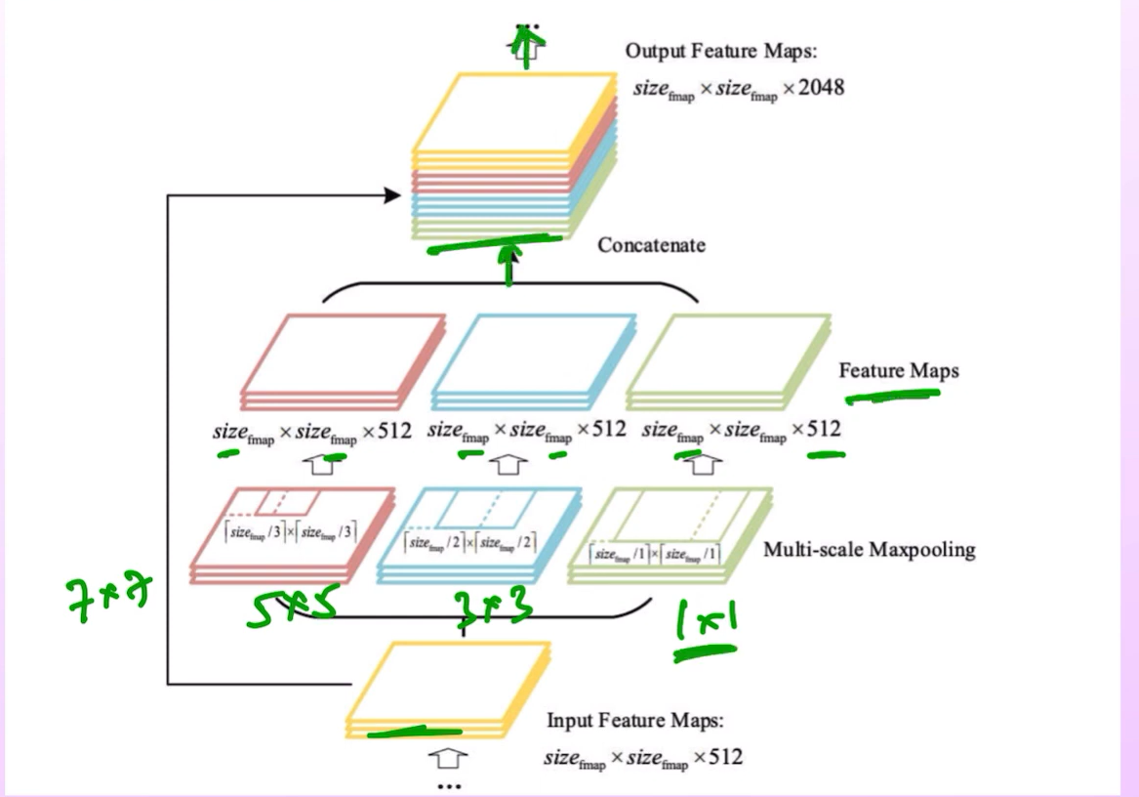
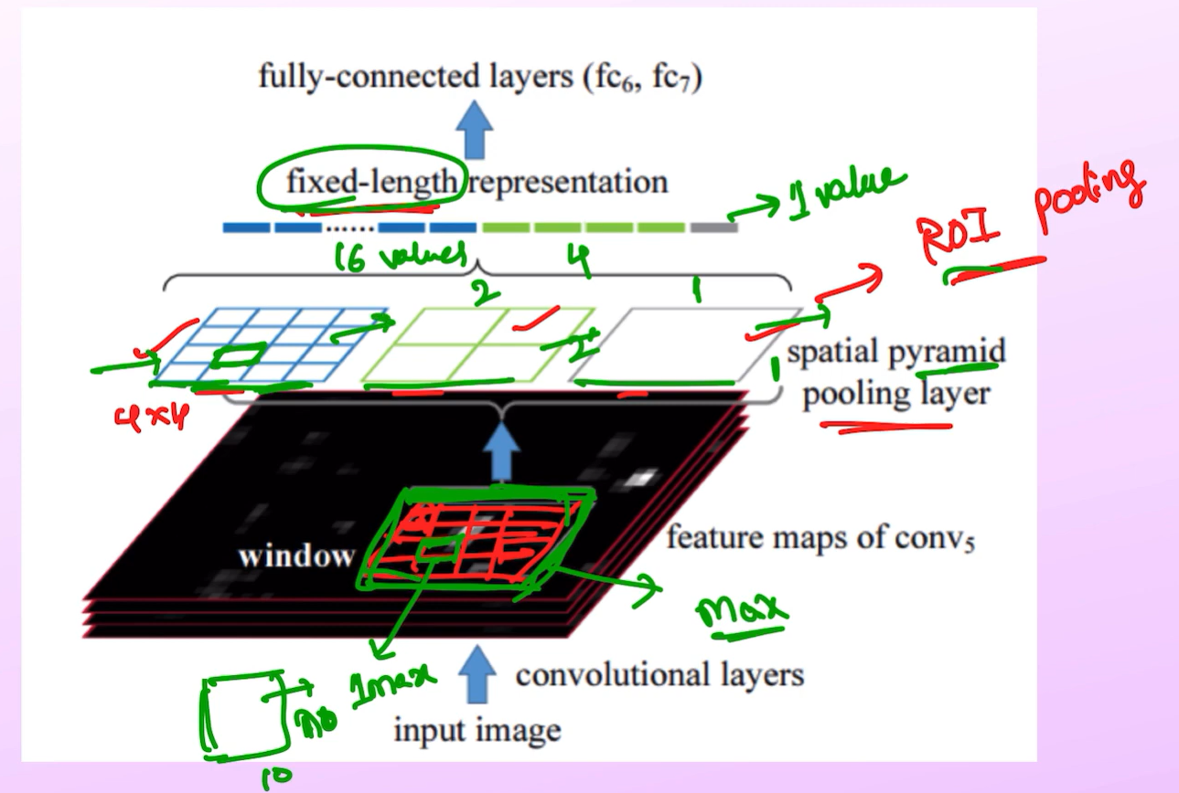
YOLOv4: SPP
Spatial Pyramid Pooling is used to get more context specific features
Helps in detecting objects at different scales
Used after last convolution layer of Backbone model
Similar to ROI pooling (fixed length)
Getting features at different levels (global to local)
Explanation of YOLOv4 components: https://youtu.be/wMQEfzsARrw

Slide 31
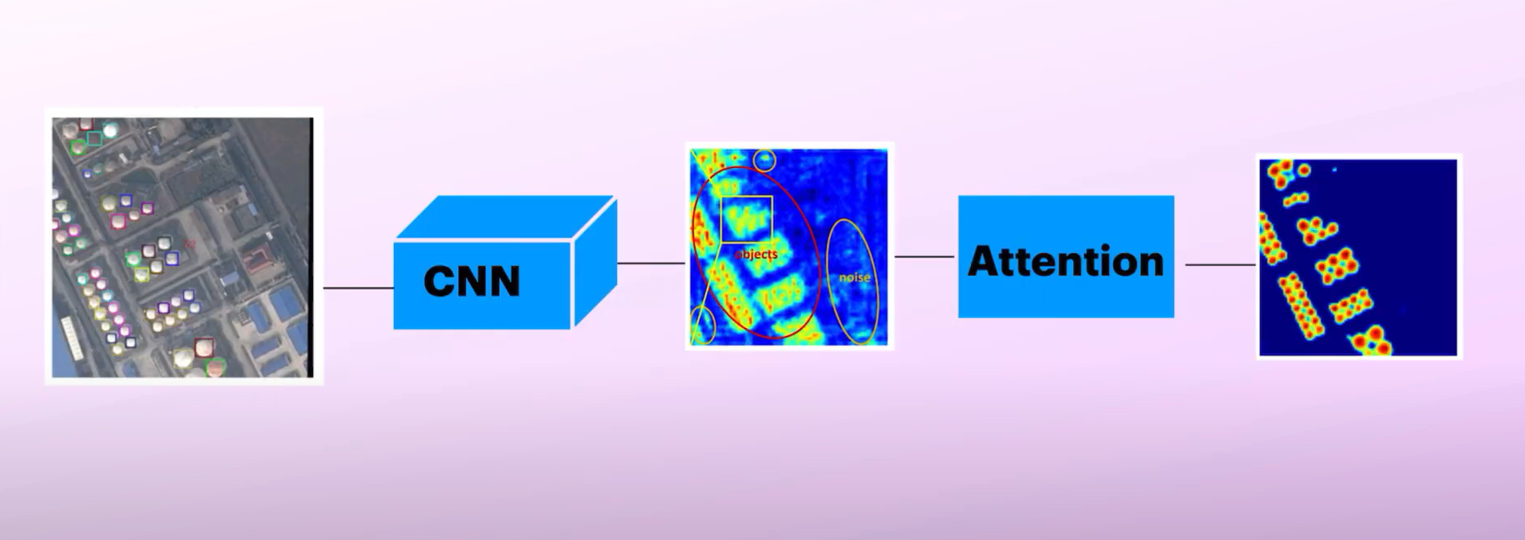
YOLOv4:
Spatial Attention Module (SAM)
Highlight relevant features and attenuate less relevant/ noisy features
Use Attention module

Slide 32
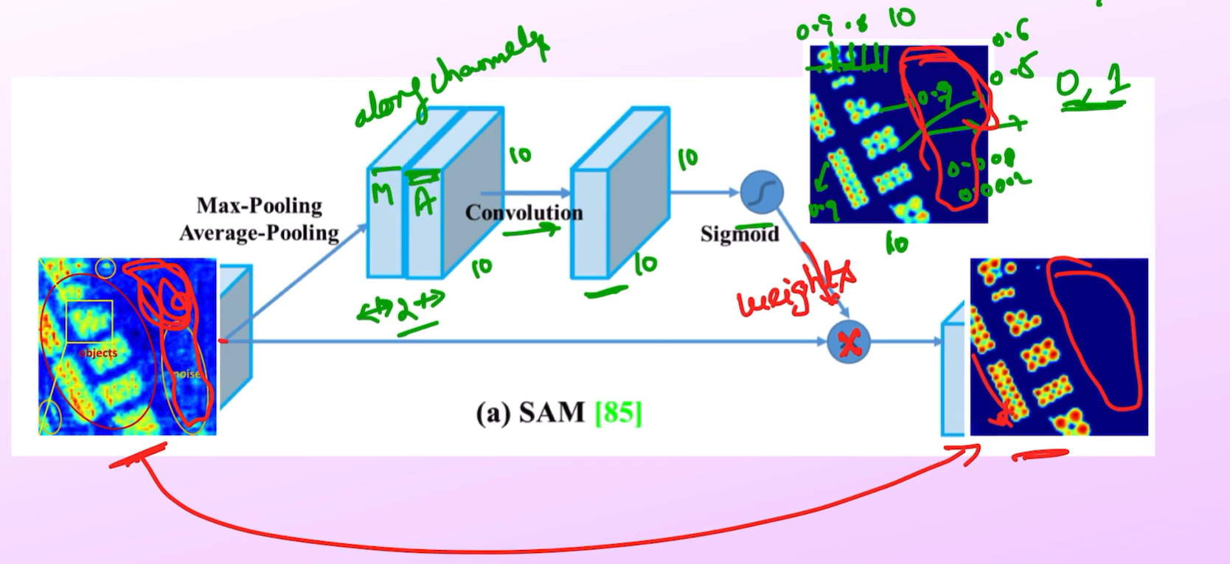
YOLOv4:
Spatial Attention Module (SAM)

Slide 33
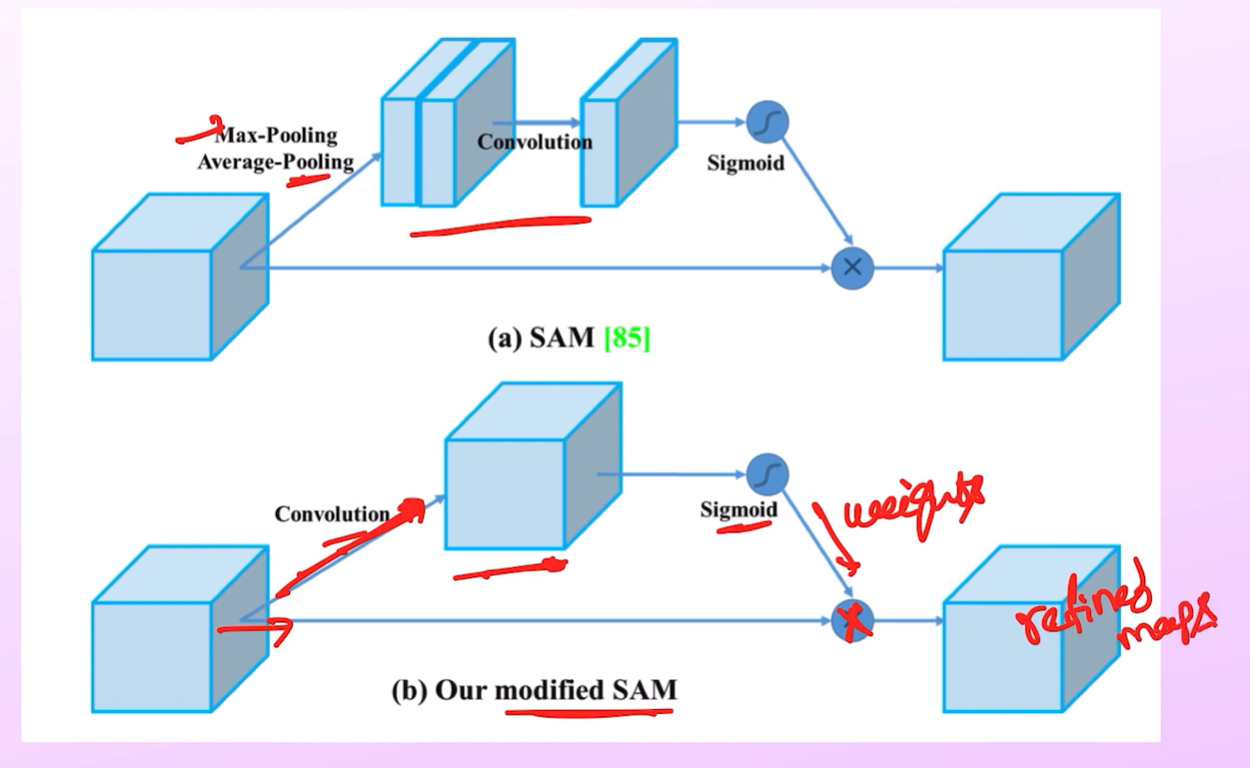
YOLOv4:
In YOLOv4 , they used a single convolution block instead of Max and Average Pooling since pooling removes information.
We learn those features using convolution.

Slide 34
YOLOv4 Performance
Achieves real-time performance with high mAP (mean Average Precision).
Can run up to 65 FPS on powerful GPUs while maintaining competitive accuracy.
YOLOv4 achieves 43.5% mAP on the COCO dataset at 65 FPS.
Designed to be compatible with most consumer GPUs, including Tesla V100 and RTX series.

Slide 35
YOLOv4 Vs. YOLOv5
Feature | YOLOv4 | YOLOv5
Framework | Darknet (C/C++) | PyTorch (Python)
Model Variants | YOLOv4, YOLOv4-tiny | YOLOv5s, YOLOv5m, YOLOv5l, YOLOv5x
Performance (Speed) | Slightly slower due to larger model size | Faster due to optimizations in PyTorch
Ease of Use | Complex setup; requires Darknet installation | Easier setup; native support in PyTorch
Training Framework | Requires Darknet; custom data preprocessing | PyTorch-based, simpler to train and customize
File Size | Larger model sizes | Smaller file sizes (~27 MB for YOLOv5s)
Training Speed | Slower, more resource-heavy | Faster, uses modern PyTorch optimizations
Optimization | Uses CSPDarknet53 for backbone | CSPDarknet53 backbone with further optimizations in PyTorch

Slide 36
YOLOv5 Vs. YOLOv8
Feature | YOLOv5 | YOLOv8
Anchor Type | Anchor-based | Anchor-free
Detection Head | Combined classification & bbox | Decoupled classification & bbox
Model Architecture | CSPNet-based Backbone | Optimized CSPNet backbone + PANet
Training Speed | Fast | Faster (more efficient pipeline)
Accuracy (COCO mAP) | High (~45.7% mAP) | Higher (~49.0% mAP)
Deployment | Flexible | More modular & user-friendly
Inference Speed (YOLOv5-S) | ~140 FPS | ~160 FPS

Slide 37
Next Lecture
We will study Transformer based Object detection systems
Overview of Transformers
Significance of attention mechanism with traditional CNN architectures

